Slide 1
Predicting Energy Consumption Using Linear Regression Models
David Culhane

Slide 2
Business Problem & Project Goal
Business Problem
Project Goal
Electricity is consumed as it is generated
Electricity producers must consistently generate electricity
Storage for fuel is finite
Appropriate amounts of fuel need to be purchased
Create models to be used for projecting energy consumption
Model projections can be used to inform business decisions
Purchasing fuel
Adjusting rates to charge for power

Slide 3
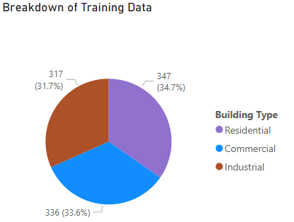
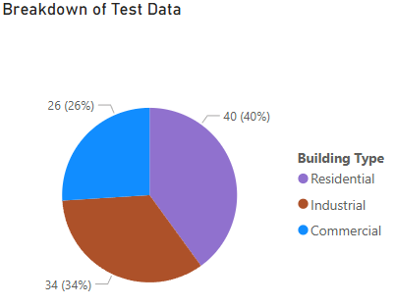
About the Data
Data was found on Kaggle at https://www.kaggle.com/datasets/govindaramsriram/energy-consumption-dataset-linear-regression/data
Training data contained 1,000 rows while Testing data had 100 rows
Data was synthetically generated with constraints to produce realistic combinations of numbers
Done specifically for modeling
Point of Caution
Fields include building type, number of occupants, number of appliances, square footage, average temperature, day of the week, and energy consumption

Slide 4
Data Preparation
Training and testing data was split by building type and then dummied to make sure all data was numeric
Data was standardized by converting to z-scores based on training data
Standardization done using Scikit-Learn’s StandardScaler()

Slide 5
Modeling the Data
Lasso and Ridge linear regression models were trained using the training data
20 values of alpha (coefficient of penalty term) were used between 0.01 and 1
Basic linear regression models were trained afterwards
All models were created using Scikit-Learn library
Helper functions were used to repeatedly train models, make predictions, score the models, and store that information into dataframes for analysis for each value of alpha

Slide 6

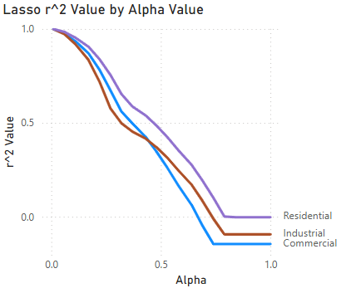
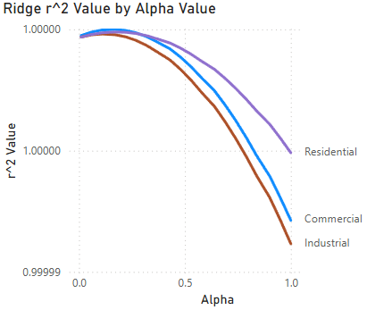
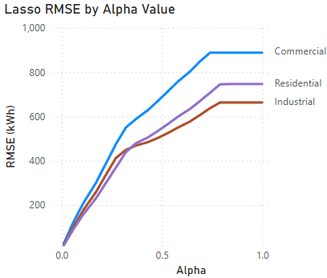
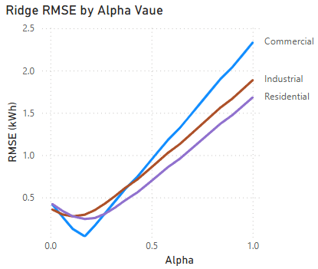
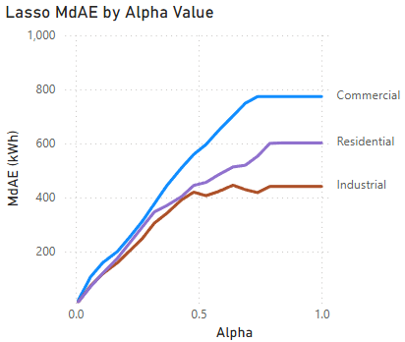
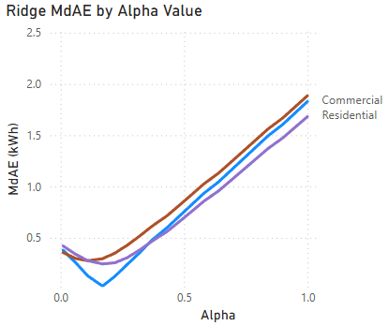
Evaluating the Models: Model Metrics
r², Root Mean Squared Error (RMSE), and Median Absolute Error (MdAE) used to score each model
Lasso models deteriorated as alpha hyperparameter increased for all building types
RMSE and MdAE values quickly increased with alpha
Error scores grew to hundreds of kilowatt-hours
Ridge models had dips at favored alpha values
RMSE and MdAE values stayed between 0-3 kilowatt-hours
Commercial and Residential models favored an alpha value of 0.17
Industrial models favored an alpha value of 0.11

Slide 7
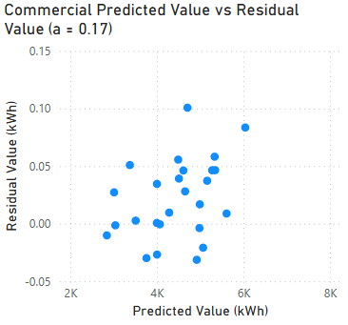
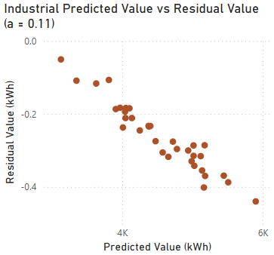
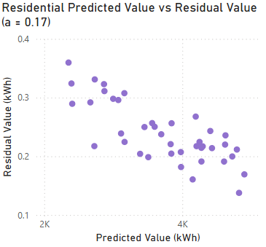
Evaluating the Models: Ridge Residuals
Commercial model residuals are split between positive and negative values
Industrial model residuals are completely negative
Indicates model over-prediction
Trend suggests increasing residual size with increasing predicted power consumption values
Residential model residuals are almost entirely positive
Indicates model under-prediction
Trend suggests decreasing residual size to a point
All residuals are within 1 kilowatt-hour of actual value

Slide 8
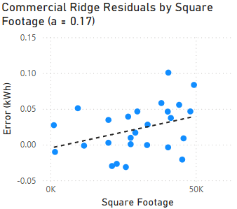
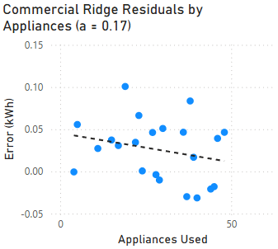
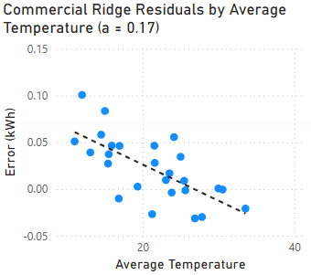
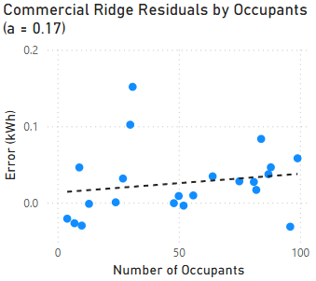
Breaking Down the Models: Commercial Ridge Model Residuals
Building square footage and number of occupants had minor positive correlations with residual size
Number of appliances and average temperature in the building had negative correlations with residual size

Slide 9
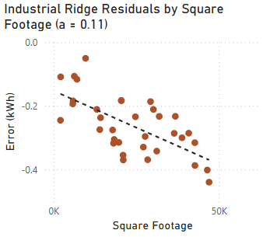
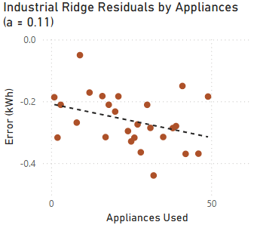
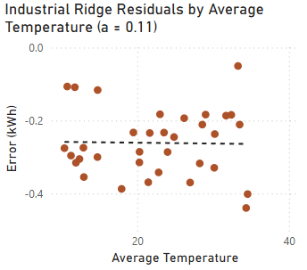
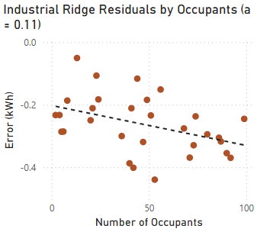
Breaking Down the Models: Industrial Ridge Residuals
Increases in all numerical component fields led to an increase in the size of residuals
Due to all residuals being negative already

Slide 10
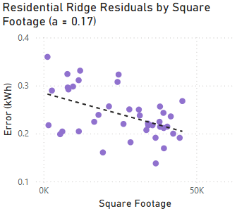
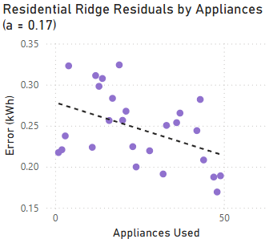
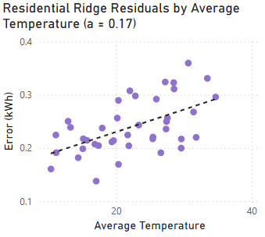
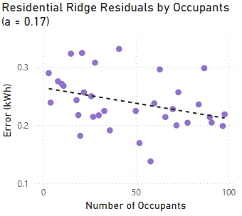
Breaking Down the Models: Residential Ridge Residuals
Average temperature had a small positive correlation with residual size
Square footage, appliances used, and number of occupants each had negative correlations with residual size

Slide 11
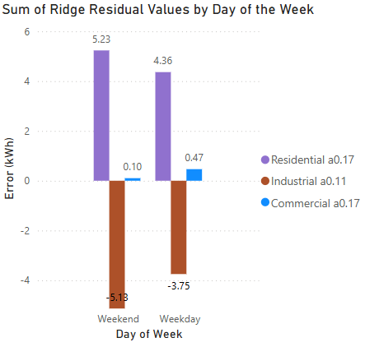
Evaluating the Models: Day of the Week Residuals
Weekend residuals were smaller for the commercial ridge model
Weekend residuals were larger for the residential and industrial models
Model prediction trends hold
Residential tends to under-predict
Commercial slightly under-predicts
Industrial tends to over-predict

Slide 12
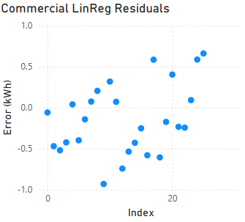
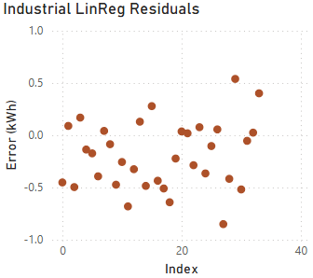
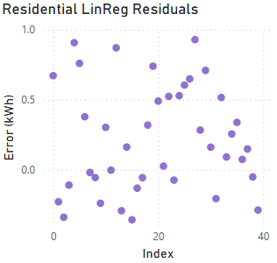
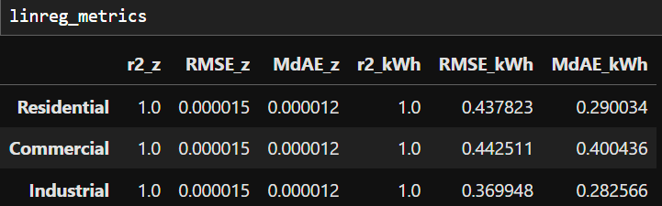
Evaluating the Models: Basic Linear Regression Residuals
Residual values are within 1 kWh of actual values
Commercial and Industrial basic linear regression models have a mixture of positive and negative residual values
Residential basic linear regression model tends to under-predict
RMSE and MdAE Values were low but larger than the values for the ridge models with their preferred alpha value

Slide 13
Model Conclusions
The lasso linear regression model was low quality
The ridge linear regression models had high quality fits with “sweet spots” for the alpha hyperparameter
The basic linear regression model also had a high-quality fit

